Slide 1

Vivekanand College for advanced
computer & information science
Robotic Process Automation
(RPA)
TY-BCA (SEM-6)
GUIDED BY :
PRESENTED BY :
Dr. Megha Polishwala
Moradiya Yash
Exam No:
2594

Slide 2
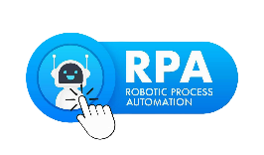
What we are going to see about RPA ?
What is Robotic Process Automation(RPA)?
Evolution of RPA
Functionalities of RPA
Components of RPA
Application of RPA
Advantages of RPA
Disadvantages of RPA
References
conclusion

Slide 3
What is Robotic Process Automation ?
The Robotic Process Automation is also known as "RPA". It supports several manual and repetitive tasks to automate like human beings. We can say that “RPA is a process of creation and training of software bot (automated programs) to automate the business process.”

Slide 4
The RPA is an acronym for Robotic Process Automation. These three terms are given below:
Robotic: The Robotic means "an entity which can be a program to mimic human actions." The unit or entity which is capable of being programmed by the computer for doing the complex tasks is called a robot.
Process: Process is the sequence of steps that leads to meaningful activity or task.
Automation: when any task happens automatically without human intervention, it is known as automation.

Slide 5
RPA, or Robotic Process Automation, is like having a digital helper for repetitive tasks. It uses software robots (bots) to do jobs in businesses without needing constant human input. Imagine it as a way to make your computer do routine work on its own.
RPA is a way to create and train these digital helpers to follow specific instructions and perform tasks automatically. The aim is to boost efficiency and cut down on the need for people to do the same task repeatedly.
The main idea behind RPA is to shift monotonous tasks to this virtual team of robots, allowing humans to focus on more interesting and creative work.

Slide 6
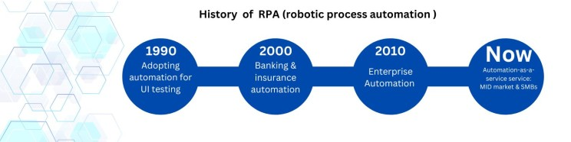
Evolution of RPA
1. 1990s - UI Testing Automation:
- Automation debuted in the 1990s with a focus on User Interface (UI) testing, marking the genesis of RPA.
- RPA originated from automating UI testing, ensuring seamless user interactions with applications.
2. 2000 - Banking & Insurance Automation:
- RPA's foundation emerged in the early 2000s with screen scraping technology, optimizing data extraction.
- Initially adopted by banking and insurance for efficiency gains, compliance improvement, and reduction of paperwork.

Slide 7
3. 2010 - Enterprise Automation:
- 2010 witnessed RPA's pivotal adoption by large-scale businesses amid a push for cost-cutting and digital transformation.
- Recognized as a cost-effective solution, RPA gained popularity for mission-critical tasks across enterprises.
4. Now - Mid-Market and SMBs Automation:
- In the 2020s, RPA democratization accelerated, departing from expensive licensing fees.
- RPA-as-a-service model, facilitated by partnerships with managed service providers, enabled smaller businesses to leverage RPA for significant productivity gains.

Slide 8

Functionalities of RPA
Task Identification
Integration with Systems
Bot Development
Rule-Based
Exclusion
Monitoring and Analytics
Continuous Improvement

Slide 9
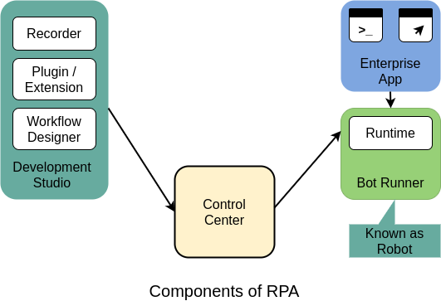
Components of RPA
Recorder
Development Studio
Plugin/Extension
Bot Runner
Control Center

Slide 10
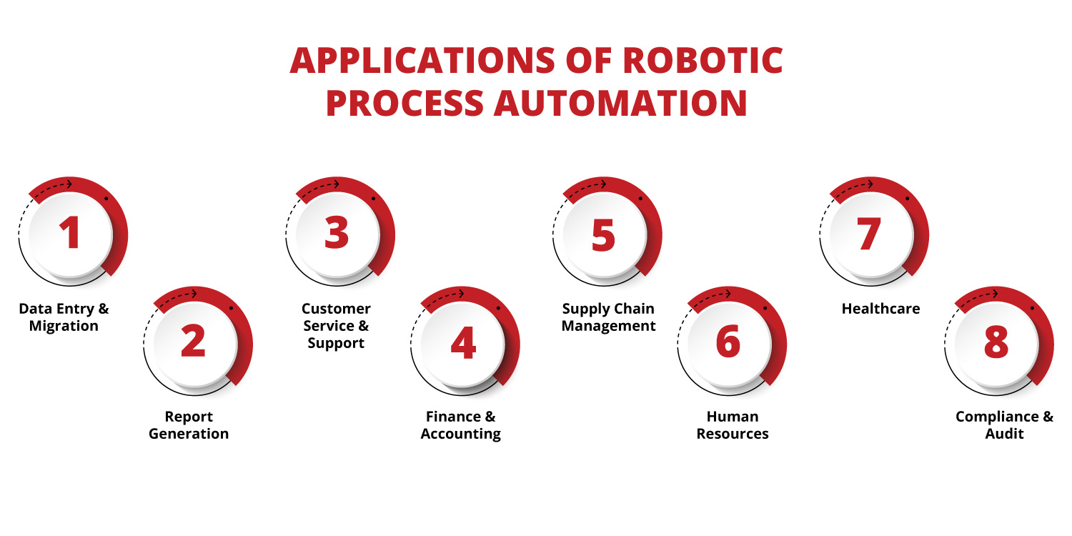
Applications of RPA
Some of the top applications of RPA:
Data Entry & Migration
Report Generation
Customer Service & Support
Finance & Accounting
Supply Chain Management
Human Resource
Healthcare
Compliance & Audit

Slide 11
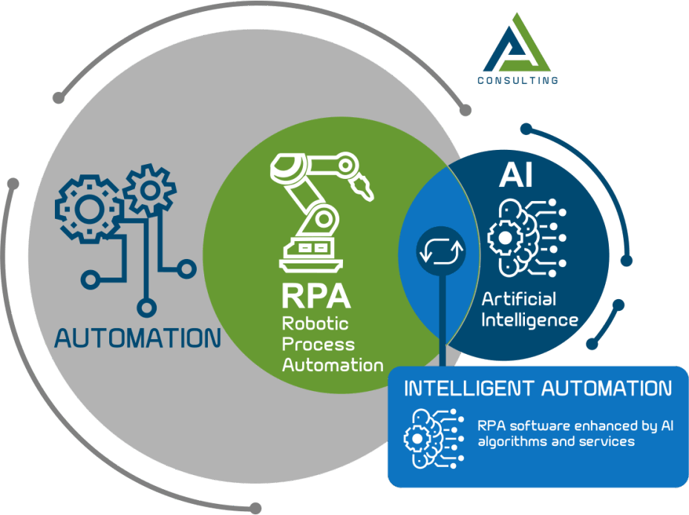
Advantages of RPA
1. Increased Efficiency
4.Quick Implementation
5. Automation Suggestions
2 Cost Savings:
3.Accuracy and
Consistency
6. Improved Customer Experience
11

Slide 12
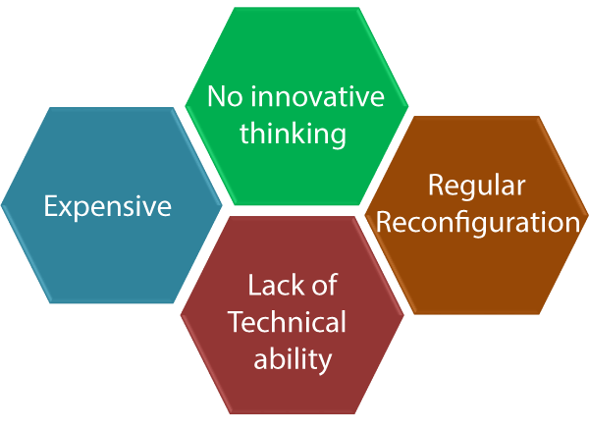
Disadvantage of RPA
1. No Innovative Thinking:
- RPA primarily focuses on automating routine tasks, potentially limiting opportunities for creative and innovative problem-solving within processes.
2. Expensive:
- Implementing RPA can involve significant initial costs, including licensing, training, and infrastructure setup, making it a potentially expensive technology.

Slide 13
3. Lack of Technical Ability:
- RPA implementation and management often require technical expertise. A shortage of skilled personnel or insufficient technical training within organizations can be a barrier.
4. Regular Reconfiguration:
- RPA systems may need frequent updates and reconfiguration to adapt to changes, adding to the workload and complexity of managing RPA implementations.

Slide 14
Conclusion
In short, Robotic Process Automation (RPA) makes work easier, but it has some challenges. It needs careful planning, and there could be resistance to change. Keeping RPA updated and secure is important. People might need to learn new skills due to job changes. Even though it costs money at the beginning, RPA brings long-term benefits like saving time and making work better. Understanding both the good and the tricky parts of RPA is important for making it work well.

Slide 15


